Slide 1
Opioid Crisis & Crime
Hans Montero & Rhys Murray

Slide 2
Background
Everyday, more than 90 Americans die from overdosing on opioids
Heroin
Morphine
Codeine
Other pain relievers
Restricting availability of prescription opioids
Since 2007, heroin overdoses have been increasing

Slide 3
Hypothesis
Not being supplied by violent gangs
Unlike crack epidemic
Comes from prescriptions
“Pill mills”
Underground prescription market
Only petty theft/burglary will be affected
Resort to theft to pay for drugs
Need money for underground market
Some muted increases in violent crime
May switch to heroin/fentanyl if supply dries up
Gang presence

Slide 4
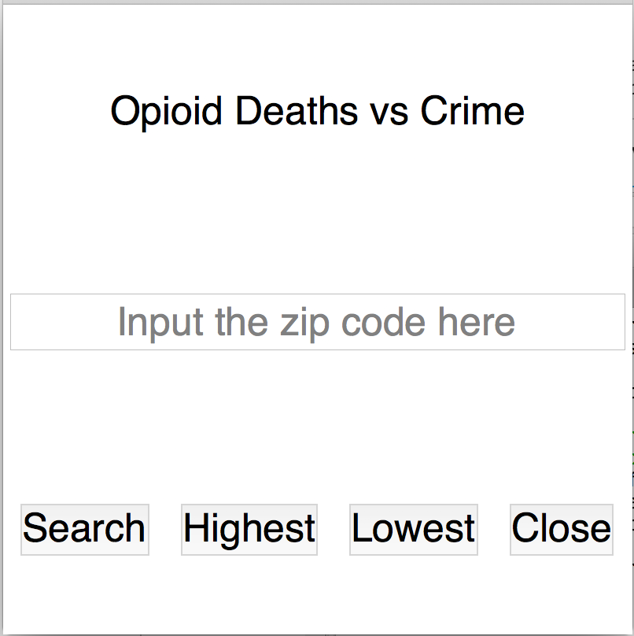
Drawing Correlations
Webscraping
Live, accurate crime website
Finds crime in inputed zip code
Graphs trends for the past 15 years
Opioid data
CDC data sheet
Graphs crude death rate in that zip code for past 15 years
GUI
Displays results in an easy to view way

Slide 5
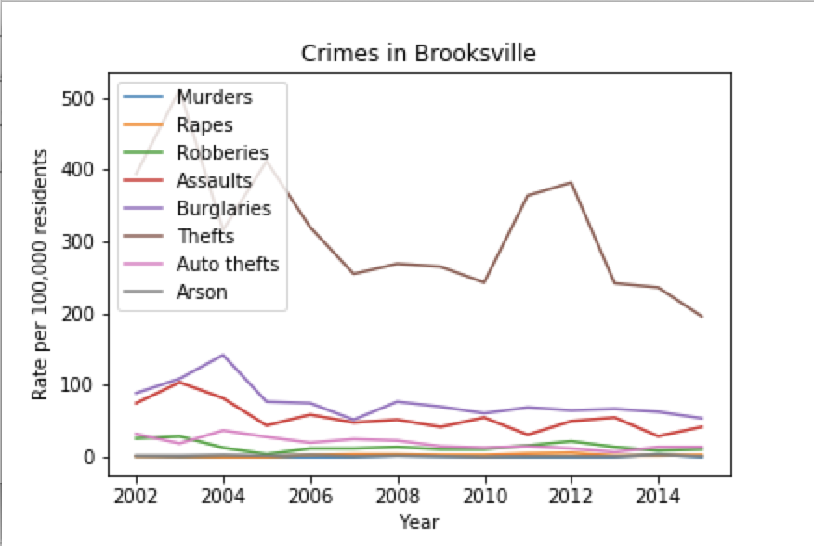
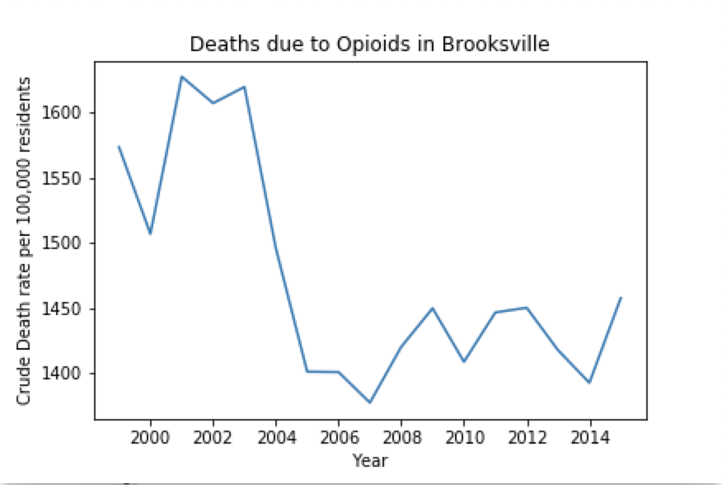
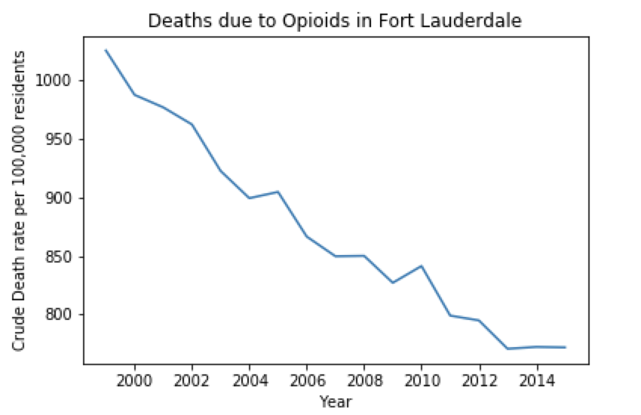
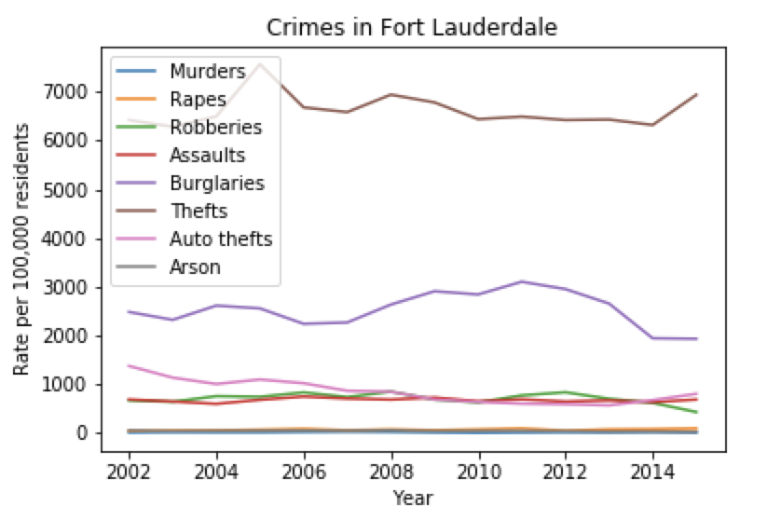
Results
Data agrees with hypothesis
Little to no correlation with violent crimes
Strong correlation with thefts and burglaries
Socioeconomics of area and location impact data
Affluent areas have low rates
Rural areas have higher rates than urban
Urban areas show gradually decreasing trend
Rural areas show stronger correlation

Slide 6
Looking Forward
Expand functionality of tool to include other factors
Socioeconomic status
Population density
Average age of region
Demographics
Non-violent epidemic
Not as much attention as necessary
Directing more funds to prevent theft
Increase security (cameras, police presence etc.)
Especially rural areas
Stopping theft will stop illegal market

